Slide 1
PROJECT TOPIC – Pixit: The Image editor
GUIDE – Dr. Kailash Kalare

Slide 2
OUR TEAM
Anagh Garg
Mohd Hamza Siddiqui
Arjama Pal
Suhani Singhal
20BAI10260
20BAI10127
20BAI10251
20BAI10033

Slide 3
01
04
Problem Statement
50% module implementation with demo
02
05
Overall architecture diagram and flow diagram
Implementation screenshot
03
06
References
Complete module split-up and explanation
Index

Slide 4
01
OBJECTIVE / PROBLEM STATEMENT

Slide 5
To design the image editor Pixit which helps in modifying images. Basically , we are using different types of filters and tools to enhance the image.

Slide 6
02
OVERALL ARCHITECTURE DIAGRAM AND FLOW DIAGRAM

Slide 7
PYTHON – VS Code
(Execution of code)
Image editor Library Module
Tkinter (tk, file dialog)
PIL(Image)
OS
User- Select Image
Image Ready to edit
Output (examples):-
Draw Rotate
Brightness Flip
Color pop

Slide 8
03
COMPLETE MODULE SPLIT-UP AND MODULE EXPLAINATION

Slide 9
Tkinter
Tkinter is the standard GUI library for Python. Python when combined with Tkinter provides a fast and easy way to create GUI applications.
Tkinter provides a powerful object-oriented interface to the Tk GUI toolkit.
Creating a GUI application using Tkinter is an easy task. All you need to do is perform the following steps −
Import the Tkinter module.
Create the GUI application main window.
Add one or more of the above-mentioned widgets to the GUI application.
Enter the main event loop to take action against each event triggered by the user.

Slide 10
PILLOW
PIL is the Python Imaging Library. The Python Imaging Library adds image processing capabilities to your Python interpreter.
This library provides extensive file format support, an efficient internal representation, and fairly powerful image processing capabilities.
The core image library is designed for fast access to data stored in a few basic pixel formats. It should provide a solid foundation for a general image processing tool.

Slide 11
04
50% MODULE IMPLEMENTATION WITH DEMO

Slide 12
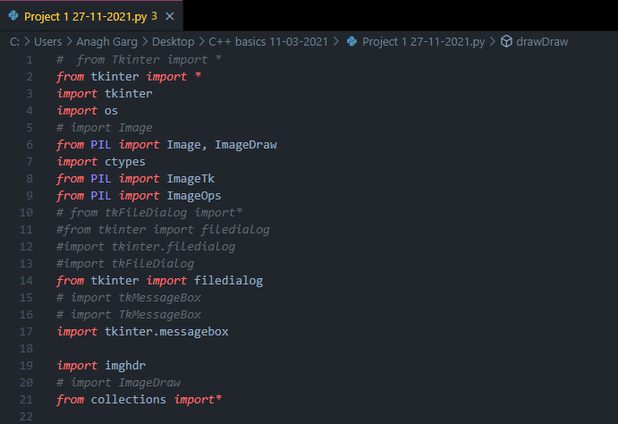

Slide 13
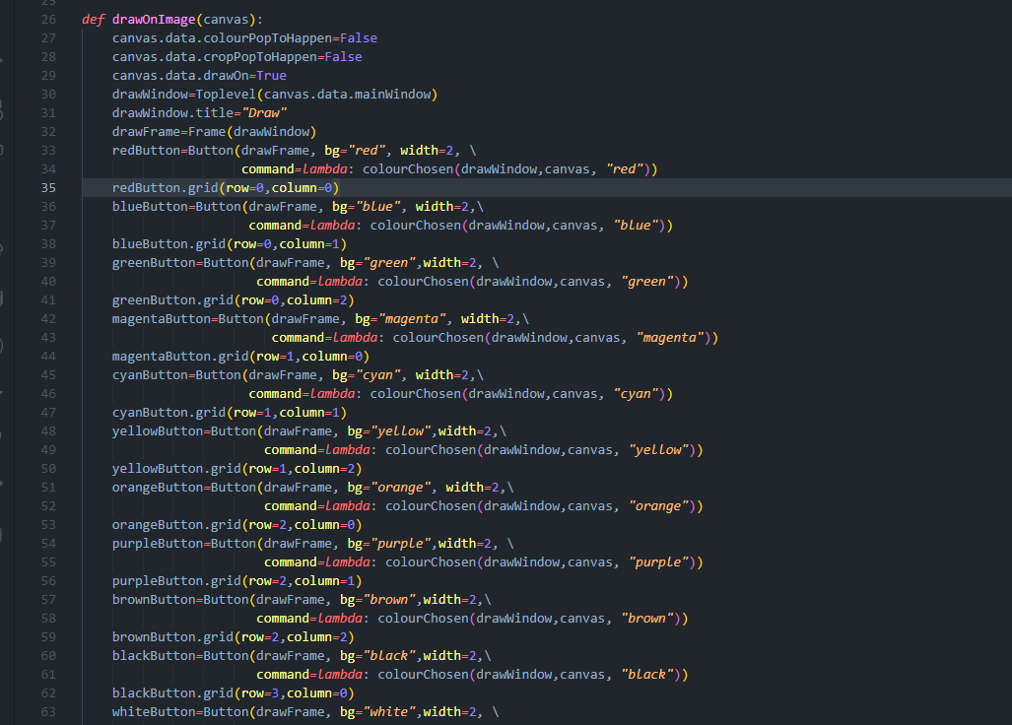

Slide 14
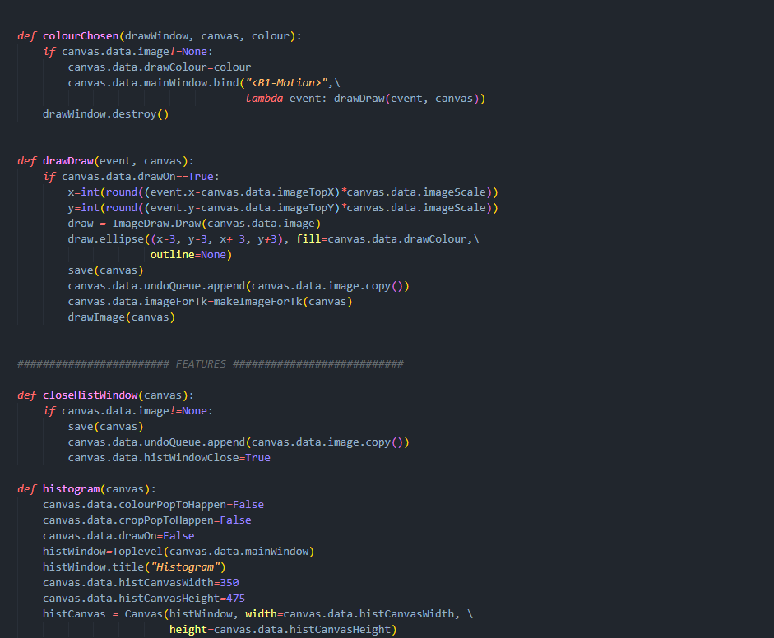

Slide 15
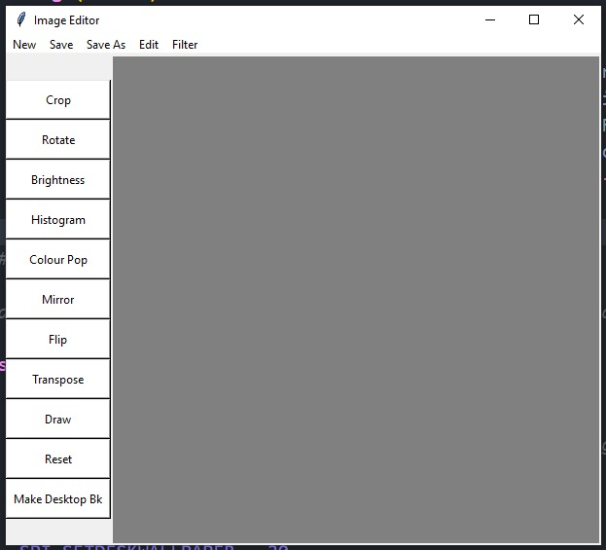

Slide 16
05
IMPLEMENTATION SCREENSHOT
You could enter a subtitle here if you need it

Slide 17
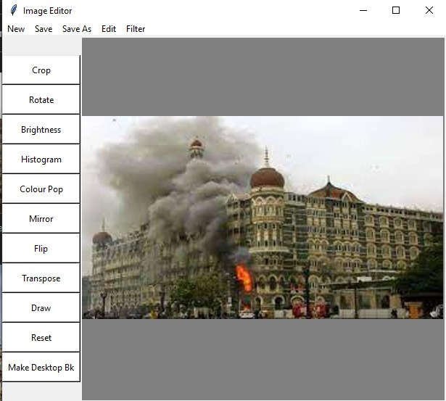

Slide 18
06
REFERENCES

Slide 19
Google
StackOverflow
GitHub
SlidesGo

Slide 20
Acknowledgement
We would like to convey our sincere gratitude to our professor Dr. Kailash kalare who gave us this platform to work on our presentation.
Teamwork is a must. We all tried to do our best and bring in the best presentation possible.​
Also, we would like to thank our senior Chaitanya Sapre and our friend Aniket Choudhary for their continuous support in our project , for their patience, motivation, and immense knowledge. Their guidance helped us in all the time.
At last we would like to thank VIT-B for giving us chance to participate and put forward our idea in this Project Exhibition.

Slide 21
Thank You

